Slide 1

Smart Attendance Tracking System
By- Kunnal Kant Lal (216320051) Shashank Kumar (216320039) Vikash Kumar (216320085)

Slide 2
Introduction
An advanced solution using face recognition to automate attendance.
Minimizes manual errors and prevents proxy attendance.
Developed using Python, OpenCV, and machine learning algorithms, this system streamlines and secures the attendance process.
Ensures accuracy, efficiency, and transparency through intelligent automation and real-time data logging.

Slide 3
OBJECTIVES
To develop accurate face recognition using OpenCV and deep learning
Integrate real-time detection to enhance security
Optimize system Performance using preprocessing and feature extraction
Ensure scalability for deployment across institutions of varying sizes.
Achieve a contactless and efficient attendance process using AI technology.

Slide 4

Tools & Technologies
Python
OpenCV
NumPy
Pandas
Face Recognition
Haar Cascade
Datetime Module

Slide 5
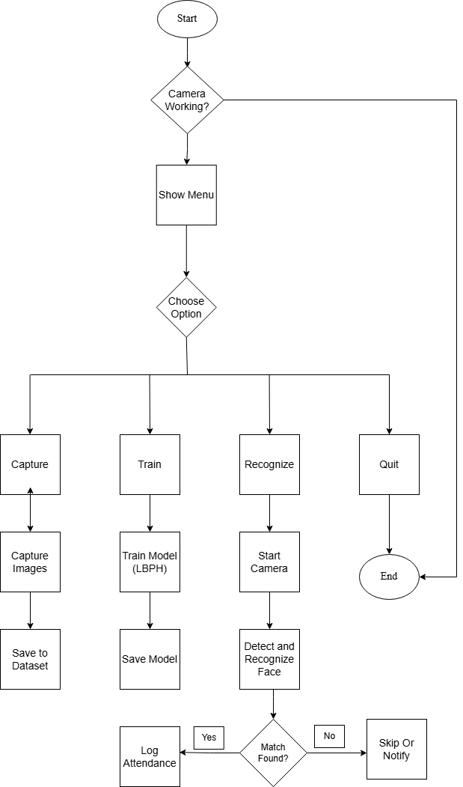
Methodology
No
Yes

Slide 6

Data Collection: Captures 150+ images per person under various lighting and angles to build a robust dataset.
Image Processing: Applies grayscale conversion, histogram equalization, and edge detection to enhance image quality for detection.
Face Detection: Uses Haar Cascade models to detect faces in real time.
Feature Extraction: Extracts unique facial features using Local Binary Patterns (LBP)
Face Recognition: Matches extracted features with stored encodings to recognize individuals.
Real-Time attendance logging: Logs attendance instantly upon successful recognition, avoiding proxy or duplication.
Security and Error Handling: Includes checks for spoofing, missing faces, and logs errors for debugging and auditing.

Slide 7

Key Algorithms and Methods
1) OpenCV (Open-Source Computer Vision Library):
OpenCV is primarily used to detect faces in real-time video streams and recognize individuals using machine learning or deep learning models.
Converts images to grayscale, applies filtering and histogram equalization to enhance image quality for better recognition. Provides tools for image processing, face detection, object tracking, etc.
Supports multiple languages like Python, C++, and Java.

Slide 8
2) Grayscale conversion:
Converts a color image (RGB) to shades of gray.
Reduces image complexity by eliminating color.
Useful for pattern detection and faster processing in computer vision.
3) CNN & LBPH for Face Recognition:
Deep learning model that extracts spatial features from images.
Highly accurate for recognizing unique facial patterns.
LBPH (local binary pattern histogram):
Simple algorithm that encodes textures and patterns in images.

Slide 9
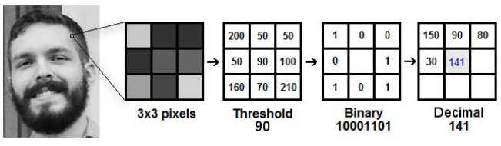
Fig-LBPH Operation
We have a grayscale image.
Select a 3x3 pixel window.
Find the center (median) value.
Compare each neighbor with the center:
Assign 1 if ≥ center, else 0.
Form an 8-bit binary number.
Convert it to a decimal value.
Replace the center pixel with this value.
Repeat for the whole image.
Result: an image with key features highlighted.

Slide 10
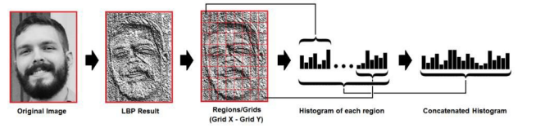
4) Histogram Equalization:
Enhances Image Contrast- It redistributes the pixel intensity values to improve contrast, making facial features more distinguishable.
Improves Face Detection Accuracy- Clearer features help algorithms like Haar cascades detect faces even in poorly lit or low-contrast images.
Preprocessing Step- Applied before face detection to standardize lighting conditions across different environments.
Boosts Edge and Feature Visibility- Essential for identifying key facial features like eyes, nose, and mouth clearly

Slide 11
5) Edge Detection:
Finds sharp changes in brightness in an image.
Helps to outline shapes like eyes, nose, and face edges.
Makes it easier for the system to understand the structure of the face.
6) Haar Cascade Detection:
A machine learning-based object detection algorithm.
Trained using positive and negative images to detect objects (like faces).
Fast and efficient for real-time applications with OpenCV.

Slide 12
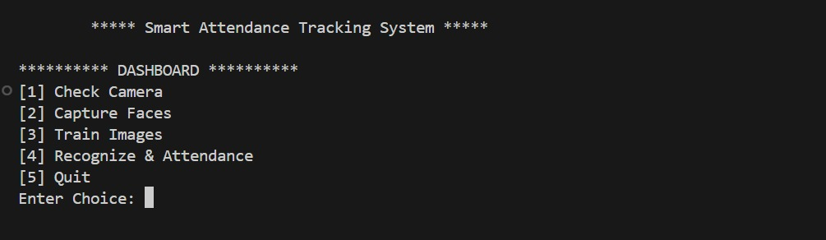
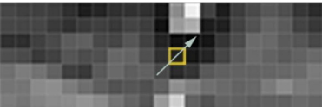
Working Model
1. Check Camera
2. Capture Faces
3. Train Images
4. Recognize & Attendance
5. Quit
STEP 1) Finding All faces:
Convert the image to black and white.
Check each pixel one by one.
Compare each pixel with its surrounding pixels.
Find where the image gets darker around that pixel.
The arrow is representing a gradient.
Do this for every pixel to show how brightness changes across the image.
A pixel in an image detected during the face detection stage

Slide 13
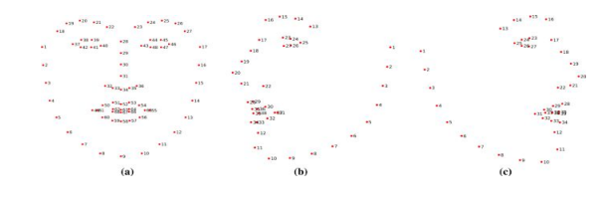
Step 2: Posing and Projecting Faces
68-points Projection

Slide 14
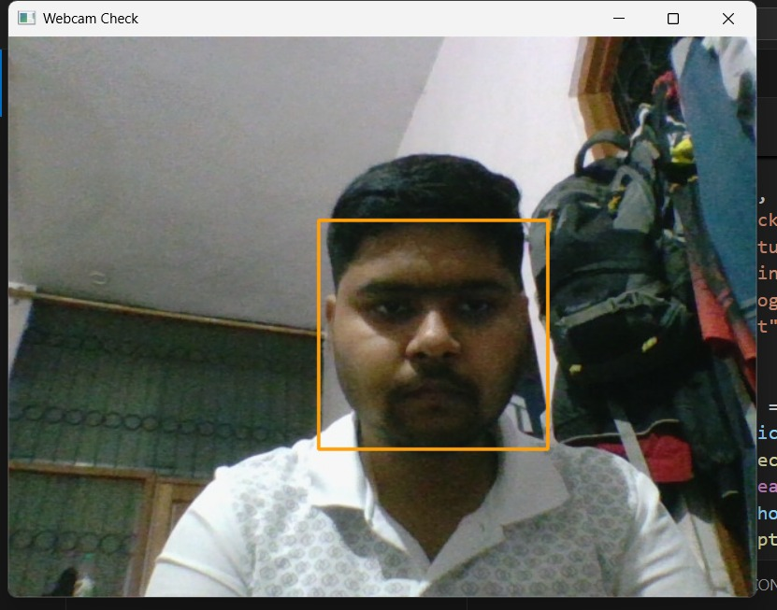
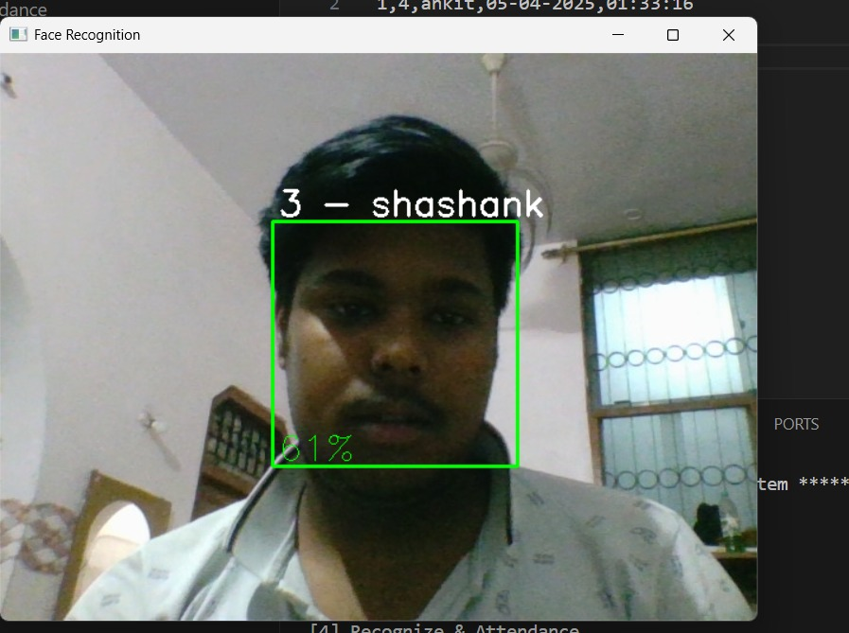
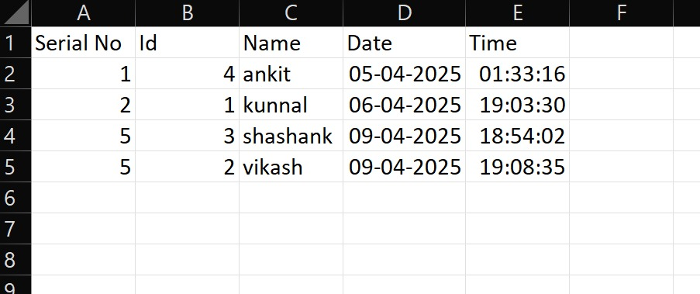
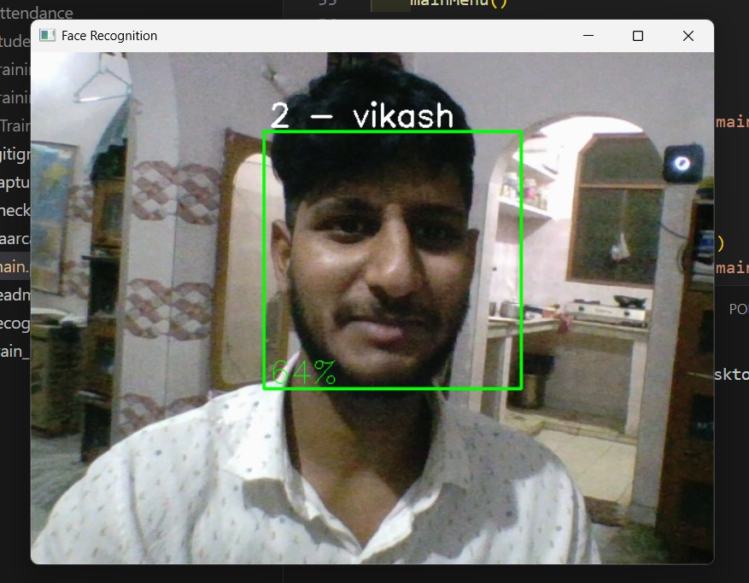
Final Step : Finding The Person’s Name From The Encoding
This last step is the easiest in the whole process. All we have to do is identify the person in our database who has the closest measurements to our test image.
Recording attendance
Fig. CSV file for the marked attendance for a small dataset

Slide 15
Results
Accurate face detection and recognition using OpenCV.
Real-time attendance marking is successful.
System detects multiple faces with good speed.
Improved image quality using preprocessing techniques.

Slide 16
Challenges
Poor lighting affects detection accuracy.
Similar-looking faces can confuse the system.
Background noise causes false detections.
High processing load for large datasets.

Slide 17
Conclusion and Future Enhancements
Conclusion
The Smart Attendance Tracking System successfully automates attendance using face recognition. It reduces manual effort, improves accuracy, and prevents proxy attendance. The system performs well in real-time environments and enhances security in institutions.
Future Scope
Improve Accuracy in Low Light: Use infrared or low-light cameras for better face detection.
Handle Similar Faces: Integrate advanced models like FaceNet or DeepFace for better distinction.
Reduce Background Noise: Use background blurring or segmentation to focus only on faces.
Optimize Performance: Implement GPU processing or model compression to handle larger datasets faster.
Add Mask Detection & Liveness Check: To prevent spoofing using printed or video faces.

Slide 18
THANK YOU !

